Slide 1
Title of the Idea : AI Interview Preparation & Feedback System
Presented By : D.Rushika
Branch & Year : CSE

Slide 2
AI Interview Preparation & Feedback System
INTRODUCTION
Interviews are essential for career success, but many candidates struggle due to lack of proper preparation and feedback.
The AI Interview Preparation & Feedback System provides simulated interviews to help users practice effectively.
Using Artificial Intelligence, the system analyzes responses to identify strengths and weaknesses.
It delivers instant, personalized feedback to improve communication, confidence, and interview performance.

Slide 3
AI Interview Preparation & Feedback System
PROBLEM STATEMENT
Many candidates lack access to realistic and consistent interview practice environments.
Existing interview preparation methods provide limited, delayed, or subjective feedback.
Manual mock interviews are time-consuming and expensive, making them inaccessible to many learners.
There is a need for an intelligent, automated system that offers personalized interview practice and instant feedback.

Slide 4
AI Interview Preparation & Feedback System
Abstract
The AI Interview Preparation and Feedback System is an intelligent software application designed to help students and job seekers improve their interview skills through simulated, real-time interview experiences. The system uses Artificial Intelligence and Natural Language Processing (NLP) to conduct mock interviews by asking technical, behavioral, and HR-related questions based on the user’s selected domain. User responses are analyzed for content relevance, clarity, confidence, grammar, and communication skills.

Slide 5
AI Interview Preparation & Feedback System
Existing System
Traditional interview preparation relies on self-study, books, and static online materials.
Mock interviews are usually conducted by human trainers, which are time-consuming and costly.
Feedback is often manual, delayed, and subjective, depending on the interviewer.
Existing platforms provide limited personalization based on individual performance.
Continuous performance tracking and detailed analytics are mostly unavailable.

Slide 6
AI Interview Preparation & Feedback System
Proposed System
The proposed system introduces an AI-powered platform for conducting realistic mock interviews.
It automatically analyzes user responses using machine learning and NLP techniques.
The system provides instant, personalized feedback on communication, technical skills, and confidence.
It adapts interview questions based on user performance and progress.
Detailed performance reports and analytics help users track improvement over time.

Slide 7
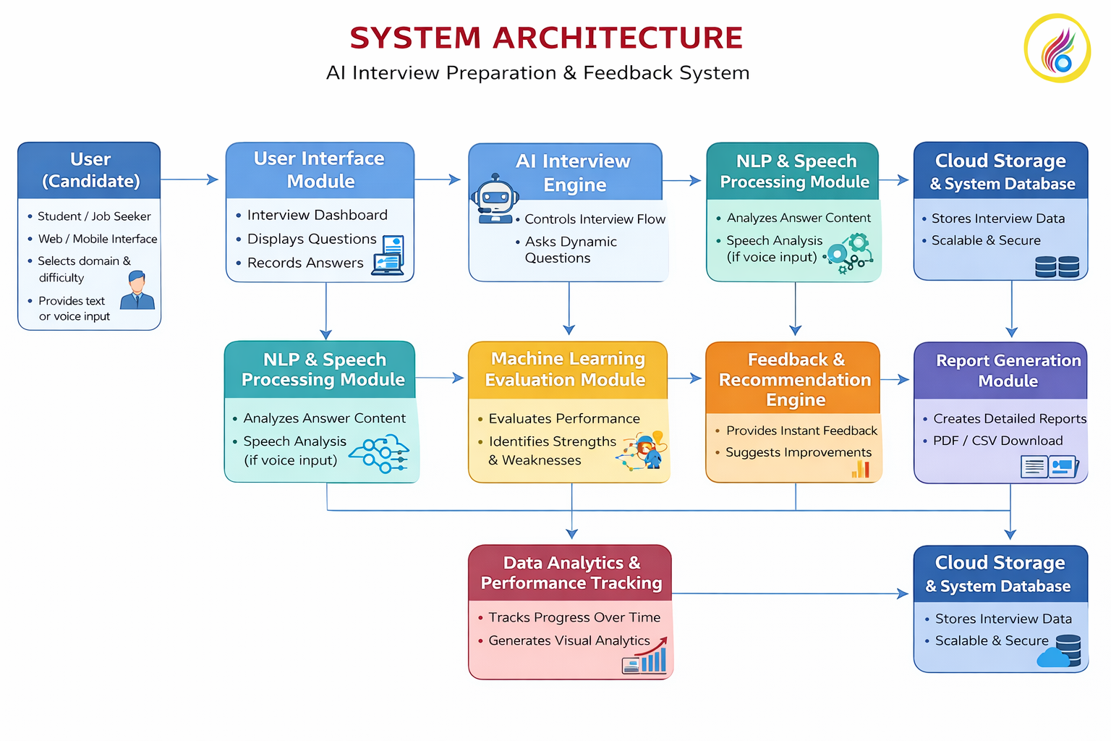
SYSTEM ARCHITECTURE
AI Interview Preparation & Feedback System

Slide 8
AI Interview Preparation & Feedback System
FEATURES:
Conducts AI-based mock interviews with technical, HR, and behavioral questions.
Analyzes user responses using AI, Machine Learning, and NLP for clarity, relevance, grammar, and confidence.
Provides instant personalized feedback and performance scores to identify strengths and weaknesses.
Generates visual performance reports and progress tracking with downloadable PDF/CSV reports.

Slide 9
TECHNOLOGIES USED
AI Interview Preparation & Feedback System
Artificial Intelligence (AI) – Controls the overall intelligent behavior of the system, such as interview simulation and decision-making.
Machine Learning (ML) – Learns from user responses to assess performance and improve feedback accuracy.
Natural Language Processing (NLP) – Analyzes spoken or written interview answers, communication skills, and language usage.
Data Analytics – Tracks performance, identifies patterns, and generates reports and improvement insights.
Cloud Computing – Enables scalable storage, remote access, and smooth system deployment.

Slide 10
AI Interview Preparation & Feedback System
ADVANTAGES:
Supports personalized learning based on individual performance.
Saves time for teachers by automating interview evaluation.
Enables continuous assessment through regular mock interviews.
Improves accuracy and confidence with instant AI feedback.
Scalable for large users through cloud-based deployment.

Slide 11
CONCLUSION
AI Interview Preparation & Feedback System
The AI Interview Preparation & Feedback System helps users prepare better for interviews by providing personalized practice and instant feedback. It allows users to understand their strengths and weaknesses and improve their communication and confidence. The system supports continuous learning through regular mock interviews and suggestions. It also saves time and cost by reducing the need for traditional coaching. Overall, it helps users perform better and increases their chances of success in interviews.

Slide 12
THANK YOU

